Slide 1
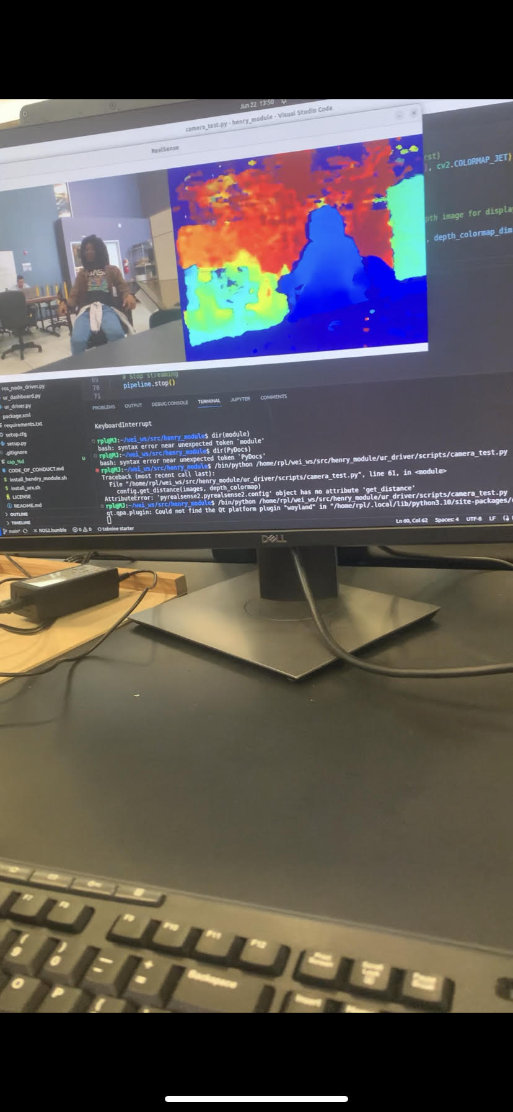

Updates:
-Got my wisdom teeth removed(Not showing a picture)
-Started gathering and displaying depth frames with Camera
-Helped Incite team with Second half of binning process and data extraction from supercomputer proposals
Future goals:
-Begin object recognition with camera
-Finish Incite binning and send outs
-Blast off some fireworks!

